Slide 1

Deep Learning Crash Course
Hui Xue
Fall 2021
www.deeplearningcrashcourse.org

Slide 2
Outline
Adversarial examples and adversarial training
Visualization of deep neural networks

Slide 3
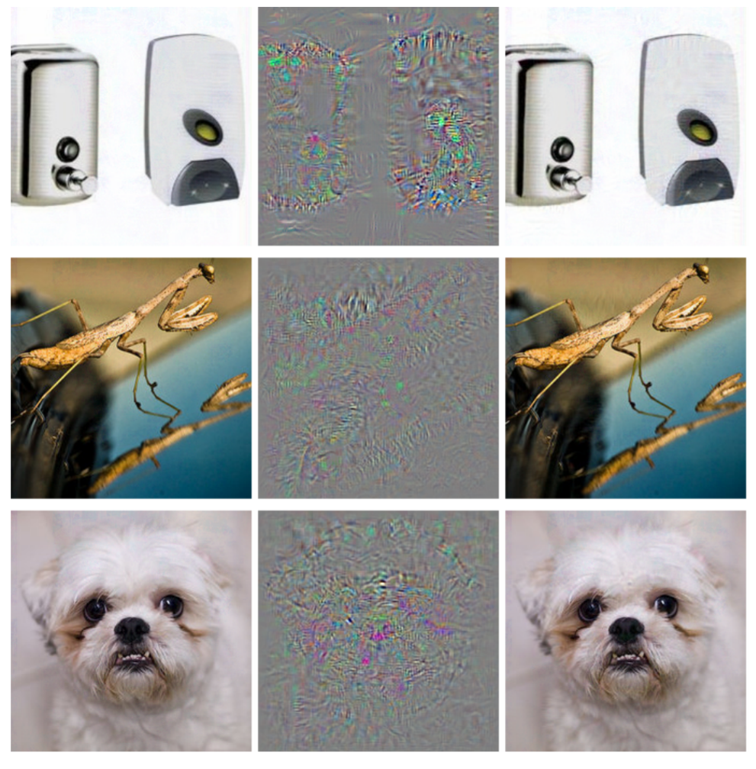
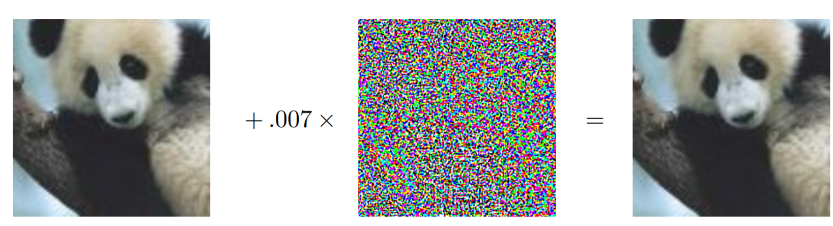
Neural networks can be hacked
Right after the taking-off of deep learning in 2012
Image + small perturbation → incorrect classification
ostrich
Panda
57.7% confidence
Gibbon
99.3% confidence
Explaining and Harnessing Adversarial Examples. 2015. https://arxiv.org/abs/1412.6572
Intriguing properties of neural networks.2014. https://arxiv.org/abs/1312.6199

Slide 4
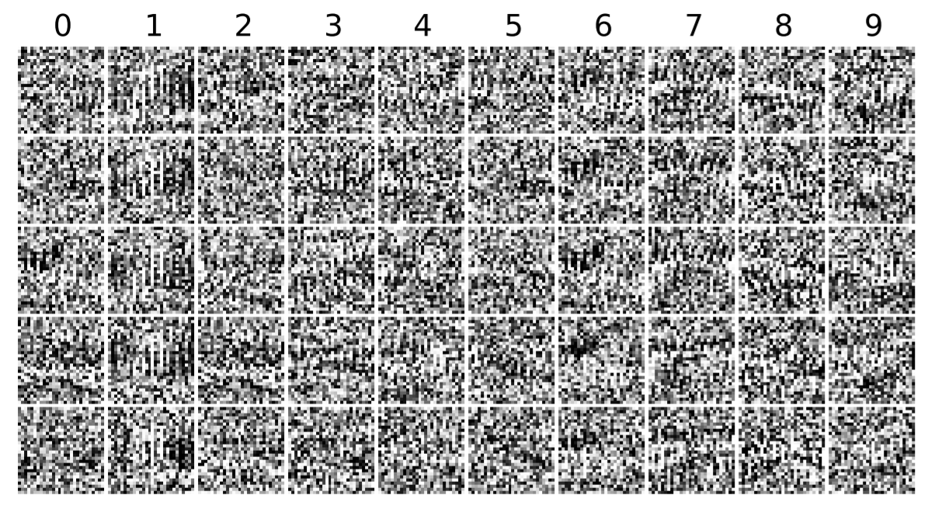
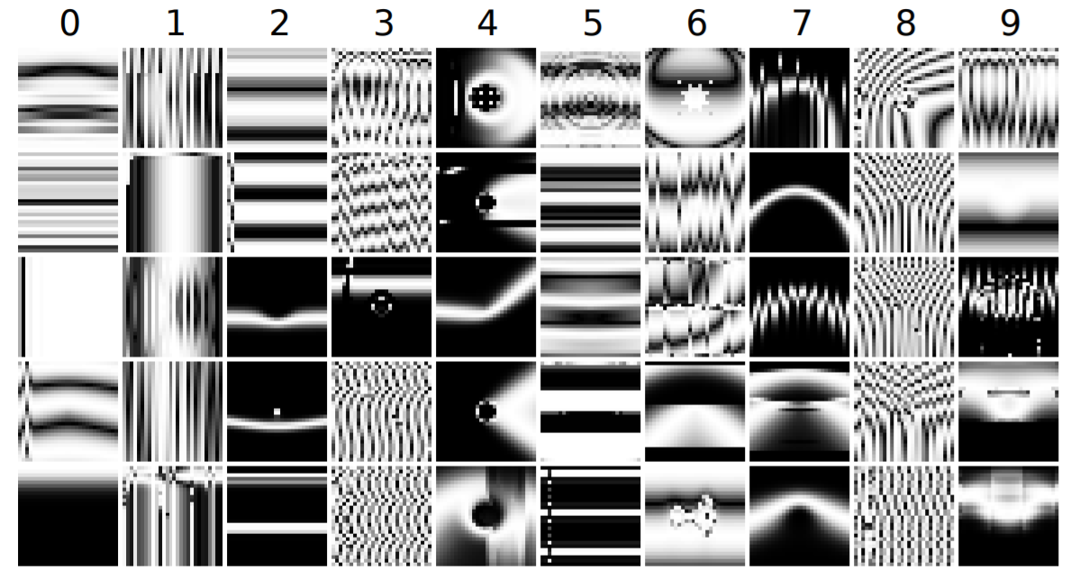
Negative examples
“it is easy to produce images that are completely unrecognizable to humans, but that state-of-the-art DNNs believe to be recognizable objects with 99.99% confidence”
Deep Neural Networks are Easily Fooled: High Confidence Predictions for Unrecognizable Images. 2015. https://arxiv.org/abs/1412.1897

Slide 5
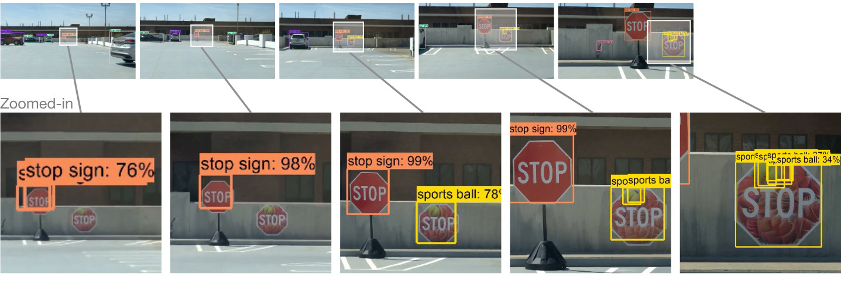
Physical examples
ShapeShifter: Robust Physical Adversarial Attack on Faster R-CNN Object Detector. 2019. https://arxiv.org/abs/1804.05810

Slide 6
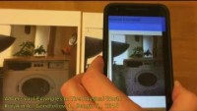
Physical examples
https://youtu.be/zQ_uMenoBCk
Adversarial examples in the physical world. 2017. https://arxiv.org/abs/1607.02533

Slide 7

Intuition
Any random sample will not be a real image …
Model fits the very limited data manifold in vast sample space
Model behavior can change drastically beyond the data manifold
Key is to find the perturbation
All images
classified as pandas
All images
classified as gibbon
Images have real looking
All real images
Real panda image
Perturbed panda image
All possible images, ${256}^{32×32×3}$

Slide 8
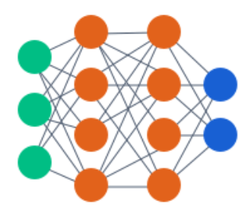
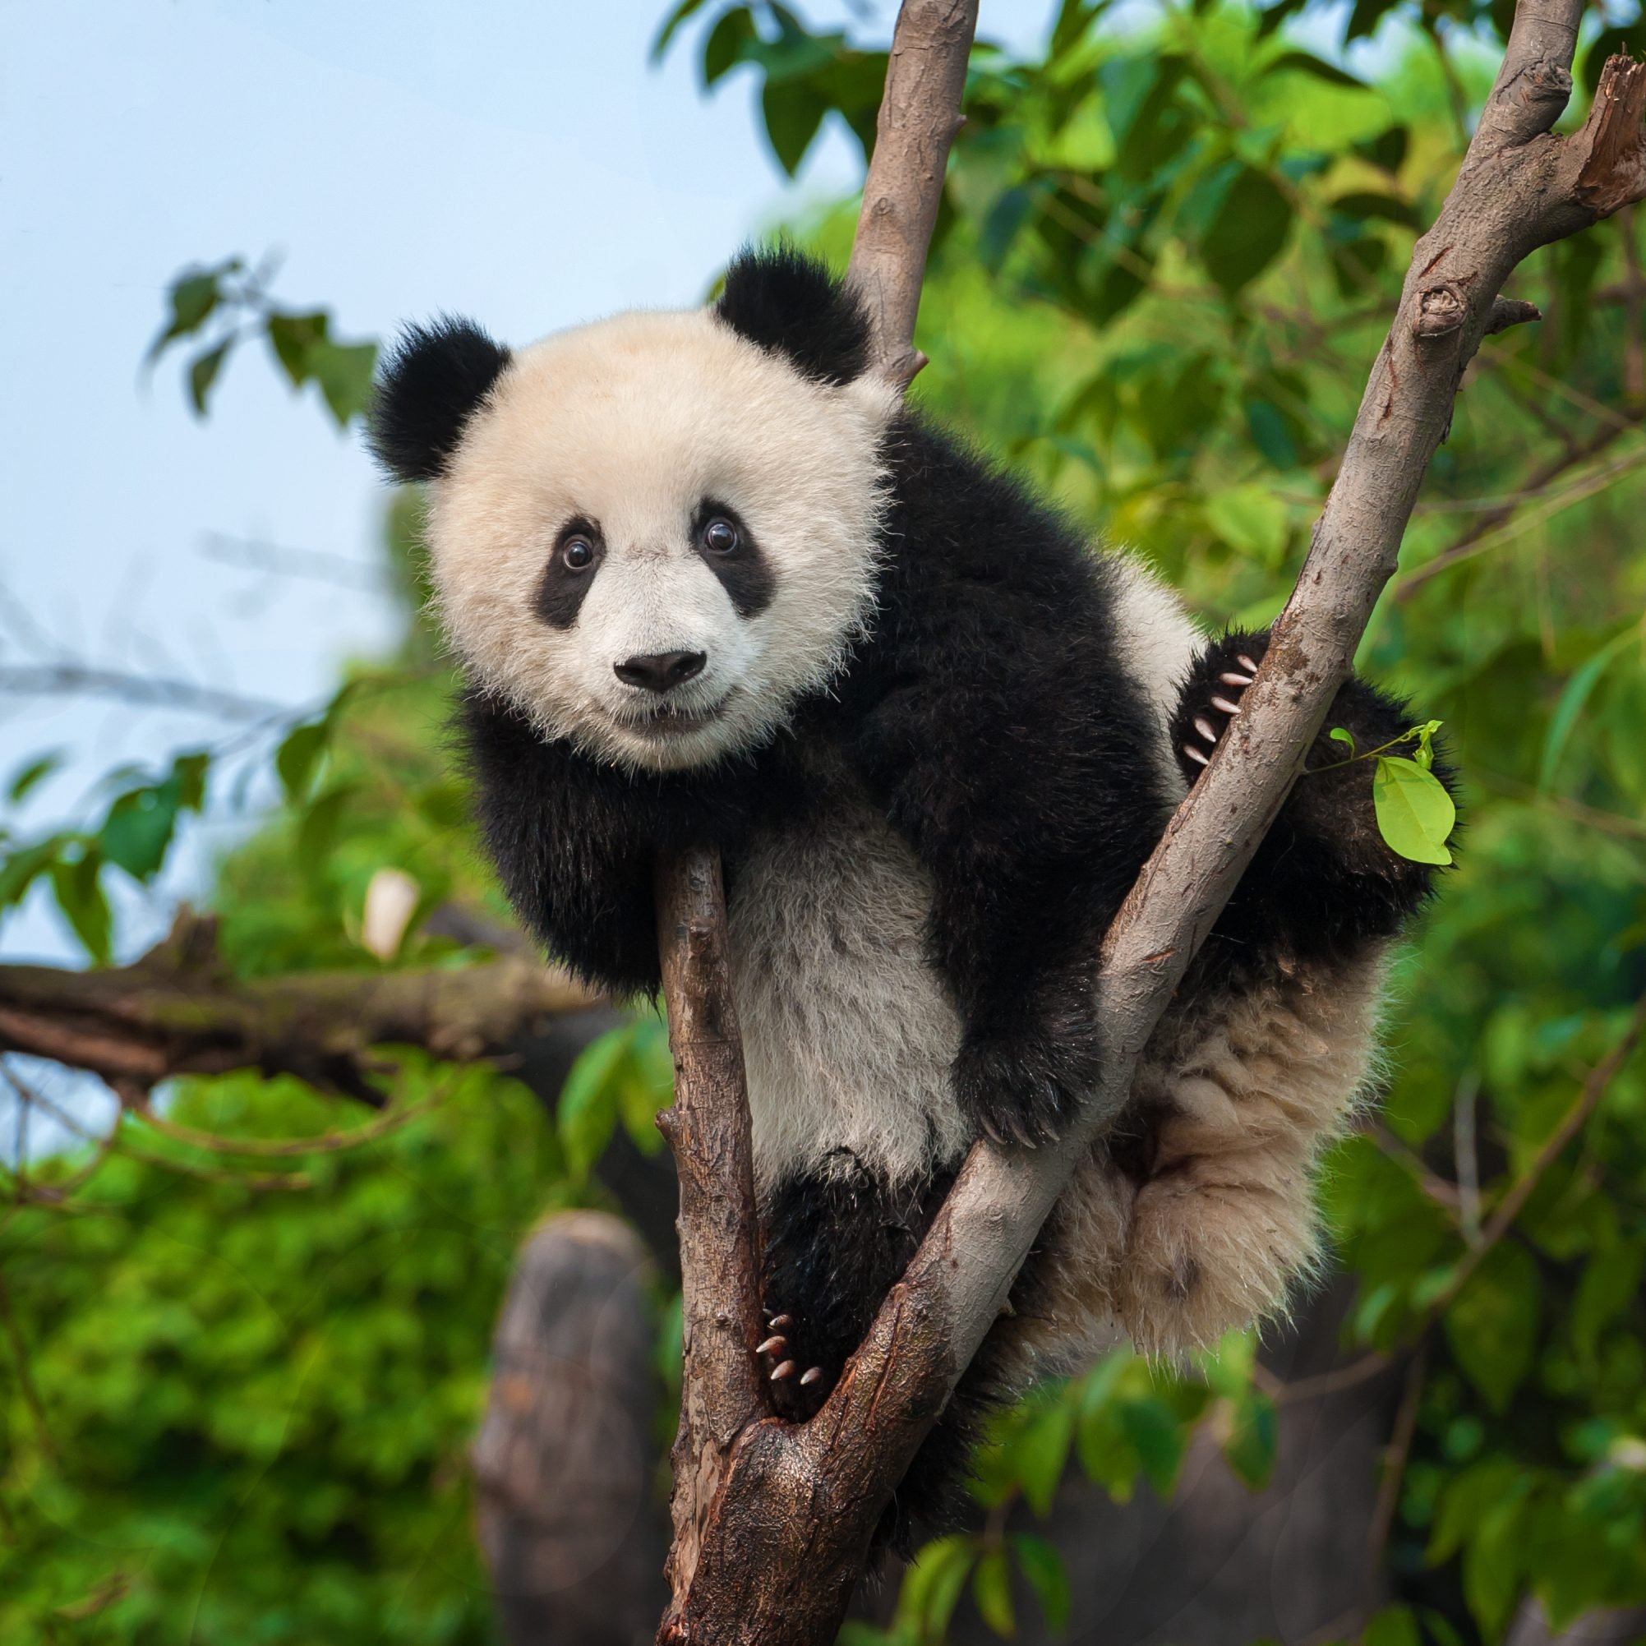
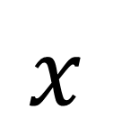
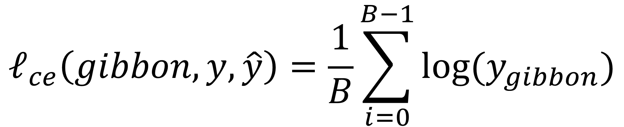
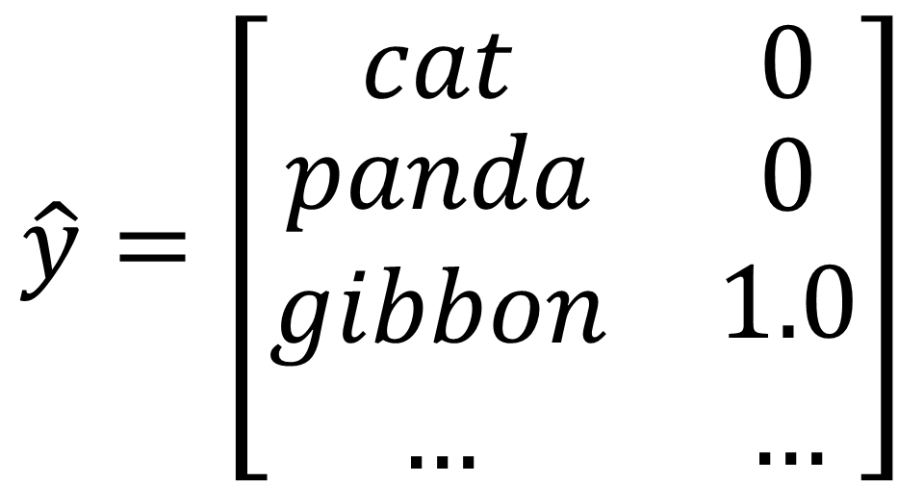
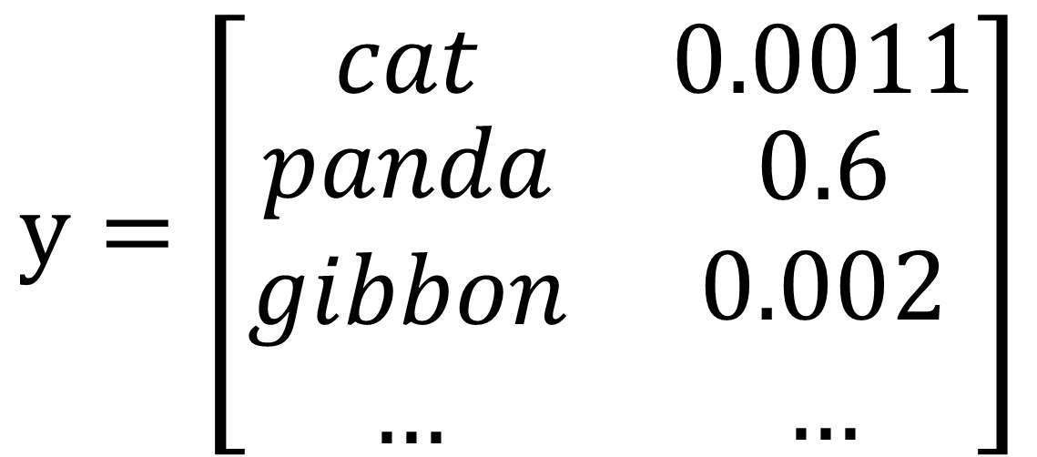
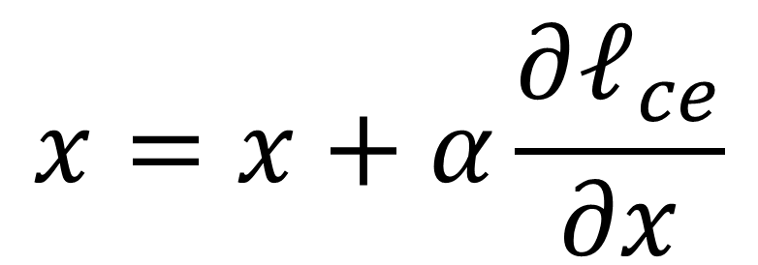
Create adversarial examples
probability
$$y=\left[\begin{matrix}cat & 0.0011 \\ \begin{aligned}panda \\ gibbon \\ …\end{aligned} & \begin{aligned}0.6 \\ 0.002 \\ …\end{aligned}\end{matrix}\right]$$
$$x$$
If we want the model to output a specific class, e.g. gibbon
Define loss between $y$ and $\hat{y}$, e.g. the cross-entropy loss
$$\hat{y}=\left[\begin{matrix}cat & 0 \\ \begin{aligned}panda \\ gibbon \\ …\end{aligned} & \begin{aligned}0 \\ 1.0 \\ …\end{aligned}\end{matrix}\right]$$
$$ℓ_{ce}\left(gibbon, y,\hat{y}\right)=\frac{1}{B}\sum_{i=0}^{B−1}{log⁡(y_{gibbon})}$$
Since the target is to change image,
$$x=x+α\frac{∂ℓ_{ce}}{∂x}$$
https://www.rd.com/wp-content/uploads/2020/03/GettyImages-1060486568.jpg

Slide 9
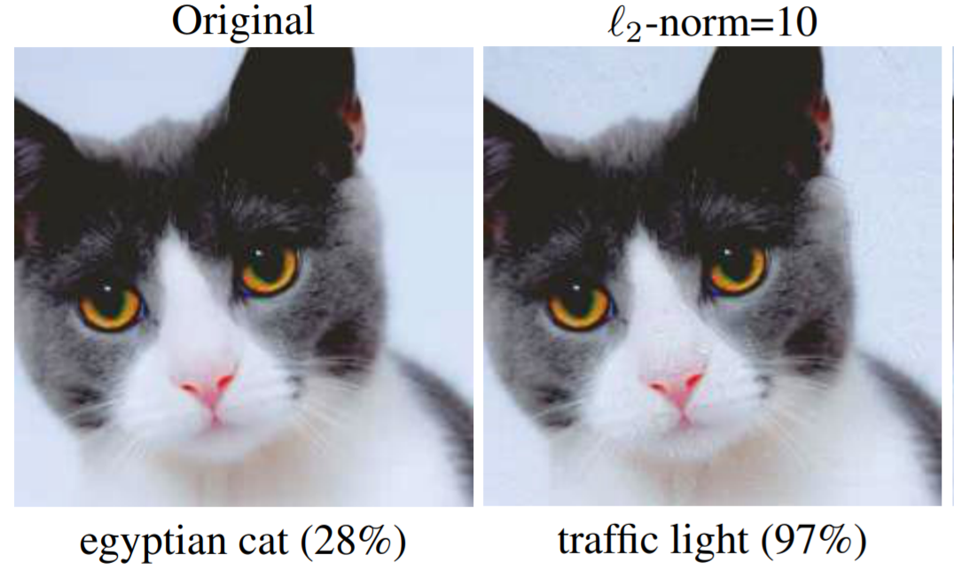
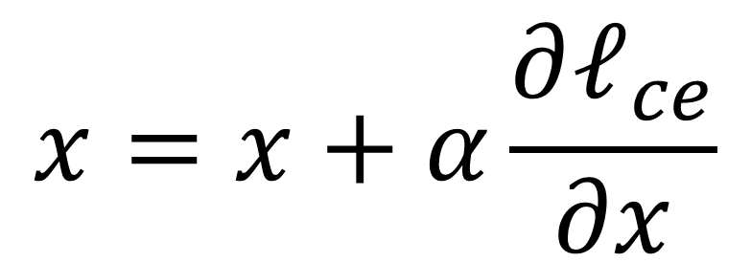
Create adversarial examples for visual assurance
$$x=x+α\frac{∂ℓ_{ce}}{∂x}$$
Update the image until the model outputs required class classification
No guarantee to get real looking images
May not be close to a panda image
Consider you are the attacker …
All images
classified as pandas
All images
classified as gibbon
Images have real looking
All real images
Are adversarial examples inevitable? 2020. https://arxiv.org/abs/1809.02104

Slide 10
Create adversarial examples for visual assurance
$$x=x+α\frac{∂ℓ_{ce}}{∂x}$$
Update the image until the model outputs required class classification
All images
classified as pandas
No guarantee to get real looking images
May not be close to a panda image
Consider you are the attacker …
All images
classified as gibbon
Images have real looking
All real images

Slide 11
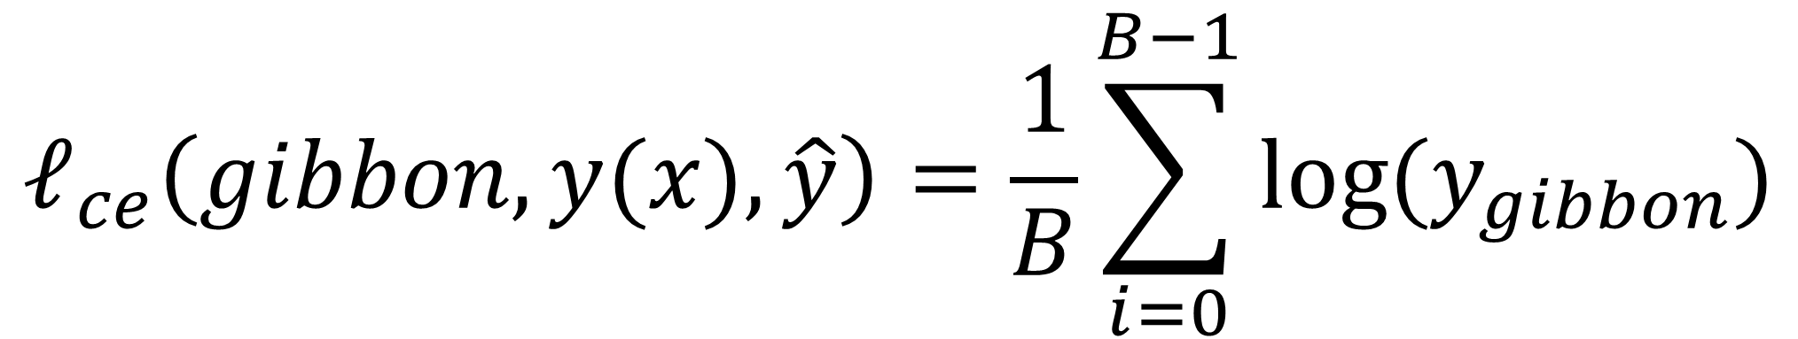
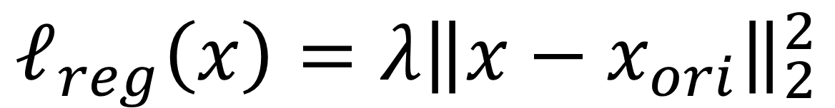
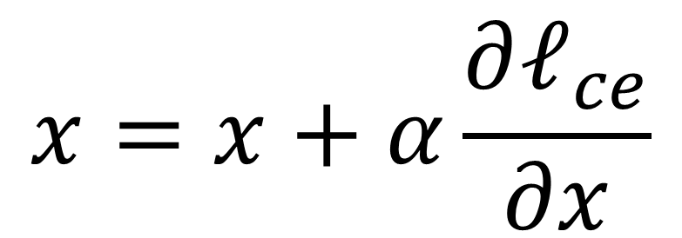
Iterative method to create adversarial examples
Define loss between $y$ and $\hat{y}$, e.g. the cross-entropy loss
$$ℓ_{ce}\left(gibbon, y(x),\hat{y}\right)=\frac{1}{B}\sum_{i=0}^{B−1}{log⁡(y_{gibbon})}$$
$$ℓ\left(x,x_{ori},\hat{y}\right)={ℓ_{ce}\left(gibbon, y(x),\hat{y}\right)−ℓ}_{reg}\left(x\right)$$
Since the target is to change image,
$$x=x+α\frac{∂ℓ_{ce}}{∂x}$$
Pick the target class
Start from the original image
Perform gradient update step in x until network is fooled
Add the regularization to encourage adversarial sample to have close visual appearance than original sample
$$ℓ_{reg}\left(x\right)={λ\left\|x−x_{ori}\right\|}_{2}^{2}$$

Slide 12
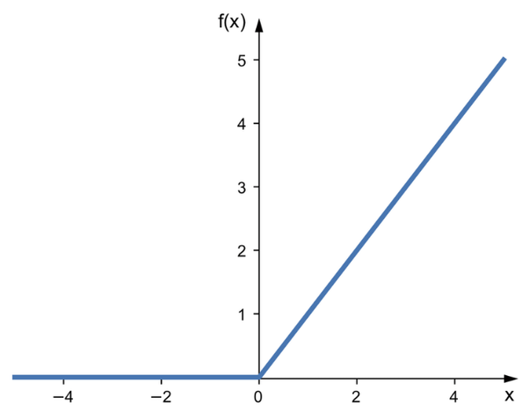
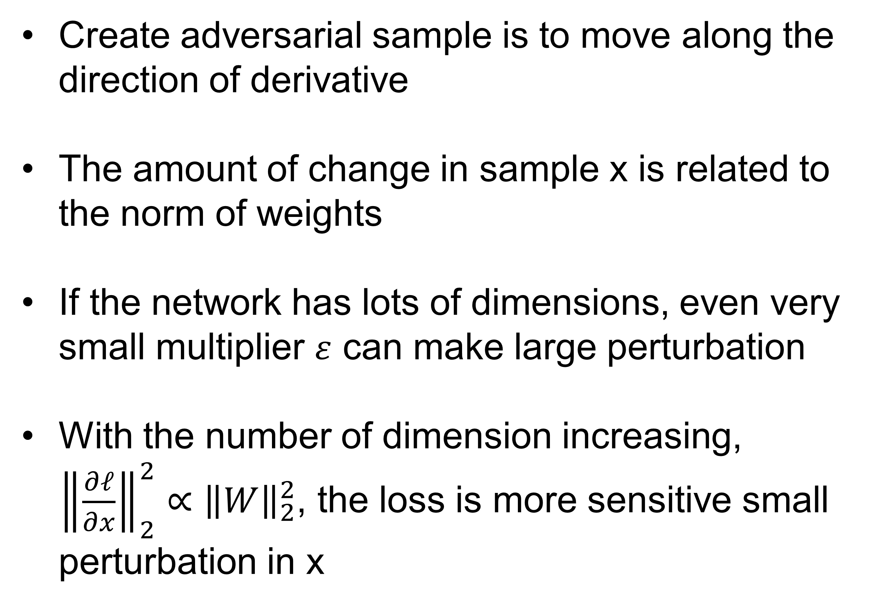
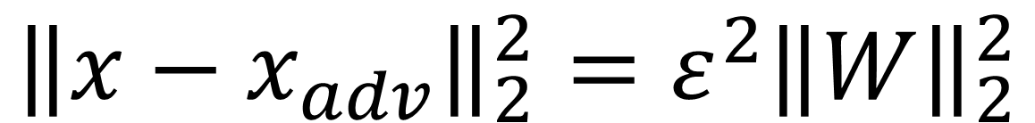
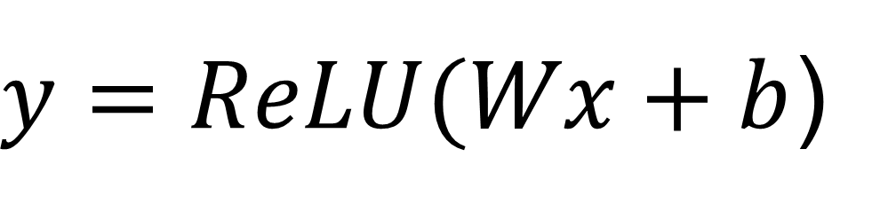
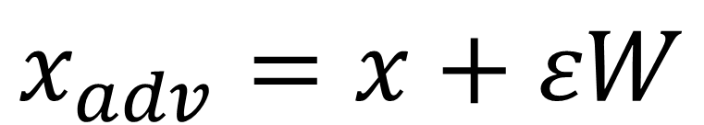
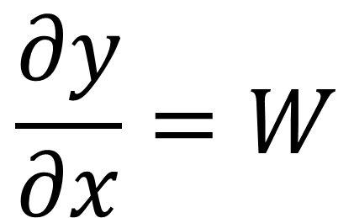
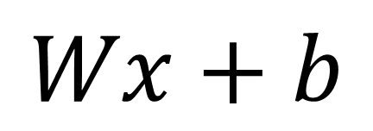
Intuition from simple model: dimensionality
Create adversarial sample is to move along the direction of derivative
The amount of change in sample x is related to the norm of weights
If the network has lots of dimensions, even very small multiplier $ε$ can make large perturbation
With the number of dimension increasing, ${\left\|\frac{∂ℓ}{∂x}\right\|}_{2}^{2}∝$ ${\left\|W\right\|}_{2}^{2}$, the loss is more sensitive small perturbation in x
$$Wx+b$$
$$\frac{∂y}{∂x}=W$$
$$x_{adv}=x+εW$$
$y=ReLU(Wx+b$)
$${\left\|x−x_{adv}\right\|}_{2}^{2}=ε^{2}{\left\|W\right\|}_{2}^{2}$$

Slide 13
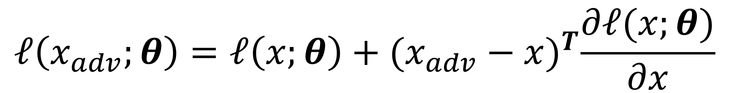
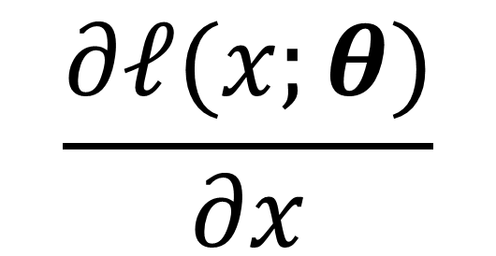
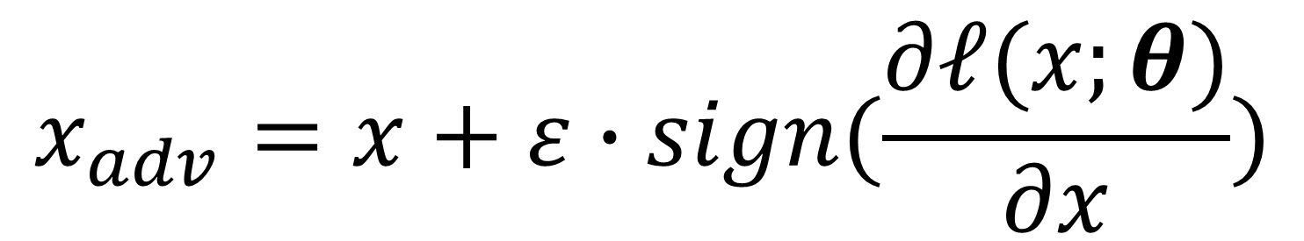
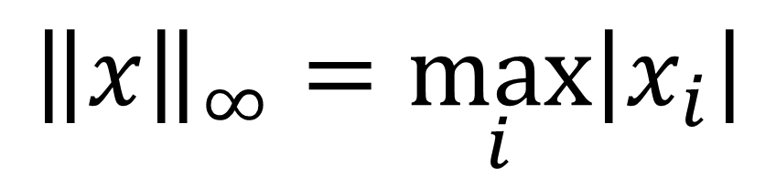
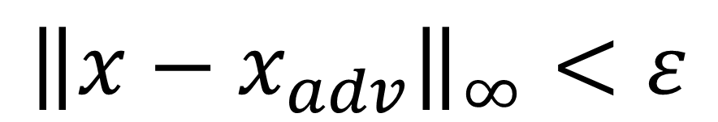
Fast gradient sign method
What is the direction to cause the largest amount of change in loss, given an input x?
$$\frac{∂ℓ(x;θ)}{∂x}$$
The gradient of loss to input x
If we want to maximize the change in loss, and also we want to limit the perturbation in input image :
$$ℓ\left(x_{adv};θ\right)=ℓ\left(x;θ\right)+{(x_{adv}−x)}^{T}\frac{∂ℓ(x;θ)}{∂x}$$
Subject to :
Infinity norm: maximal absolute value among all elements in x
$${\left\|x−x_{adv}\right\|}_{∞}<ε$$
$${\left\|x\right\|}_{∞}=\max_{i}\left|x_{i}\right|$$
$$x_{adv}=x+ε∙sign(\frac{∂ℓ(x;θ)}{∂x})$$
Explaining and Harnessing Adversarial Examples. 2015. https://arxiv.org/abs/1412.6572

Slide 14
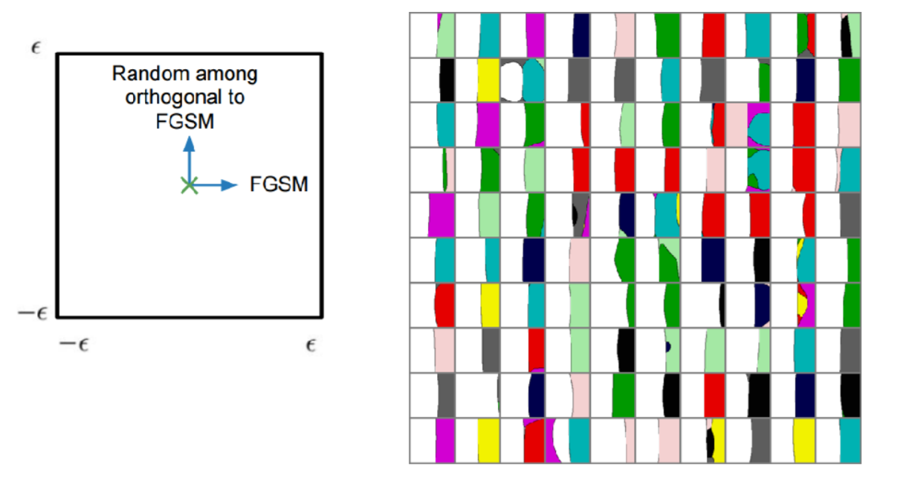
Intuition from the fast gradient sign method
Perturbation along the direction to increase loss fools the model effectively
Adversarial samples are concentrated at least in some regions
Explaining and Harnessing Adversarial Examples. 2015. https://arxiv.org/abs/1412.6572
https://www.iangoodfellow.com/slides/2017-05-30-Stanford-cs213n.pdf

Slide 15
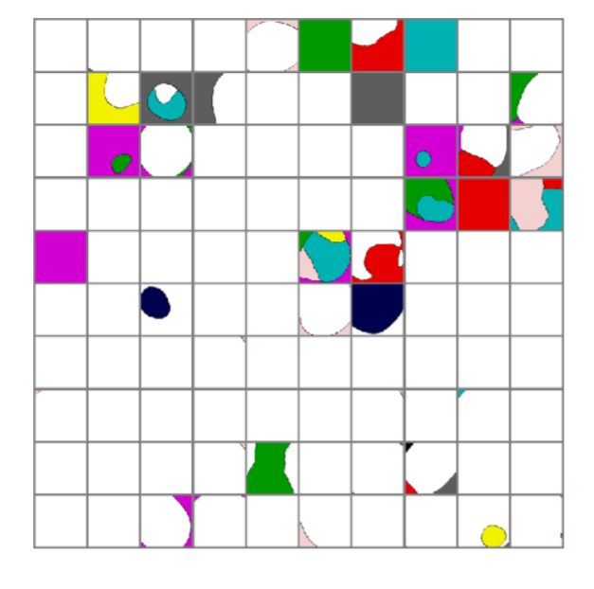
Intuition from the fast gradient sign method
Random perturbation is not effective to fool the model
It indicates the adversarial samples are not randomly distributed, but rather on some continuous manifold
Explaining and Harnessing Adversarial Examples. 2015. https://arxiv.org/abs/1412.6572
https://www.iangoodfellow.com/slides/2017-05-30-Stanford-cs213n.pdf

Slide 16
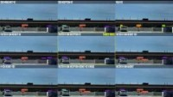
Adversarial examples with transferability
Adversarial samples created from one model can often fool other models. In other words, these attacking samples can be transferred between models
Untargeted attack causing the missed detection to stop sign
Test on 9 models
Quite some models missed the stop sign, even the adversarial sample was prepared for a particular model
https://youtu.be/4KFhULX3v58
ShapeShifter: Robust Physical Adversarial Attack on Faster R-CNN Object Detector. 2019. https://arxiv.org/abs/1804.05810

Slide 17
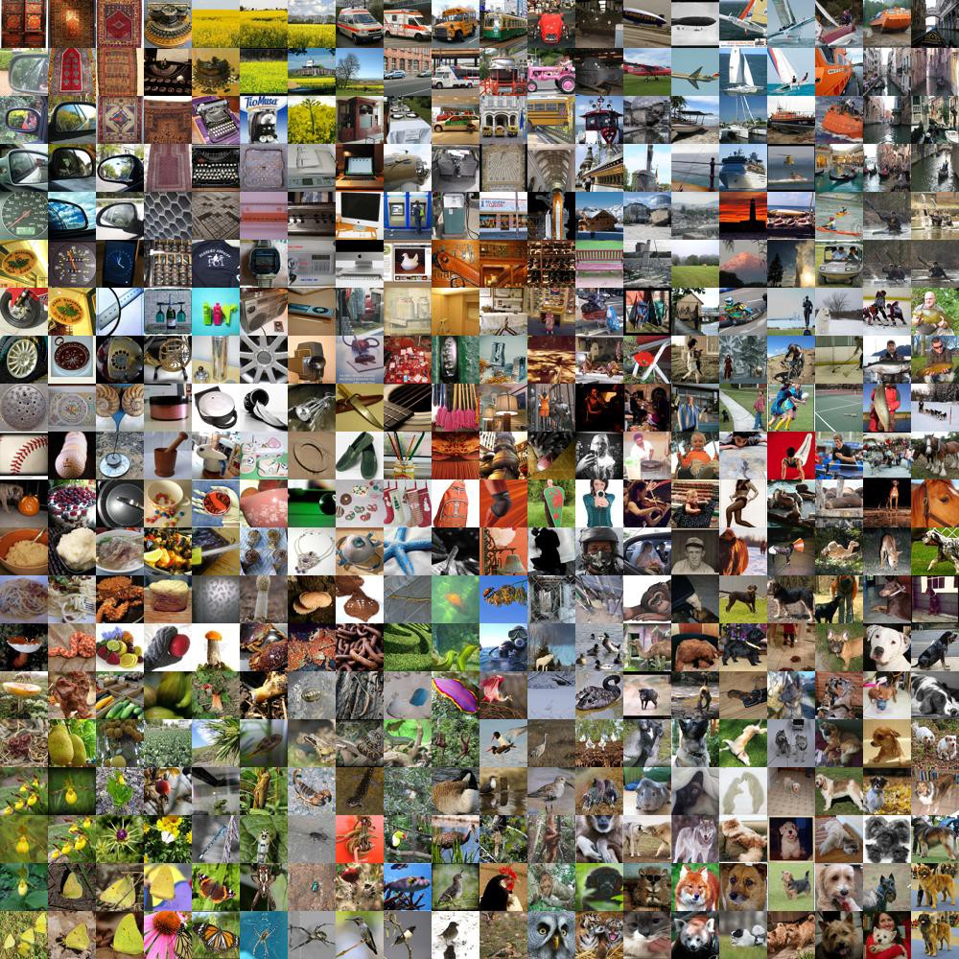
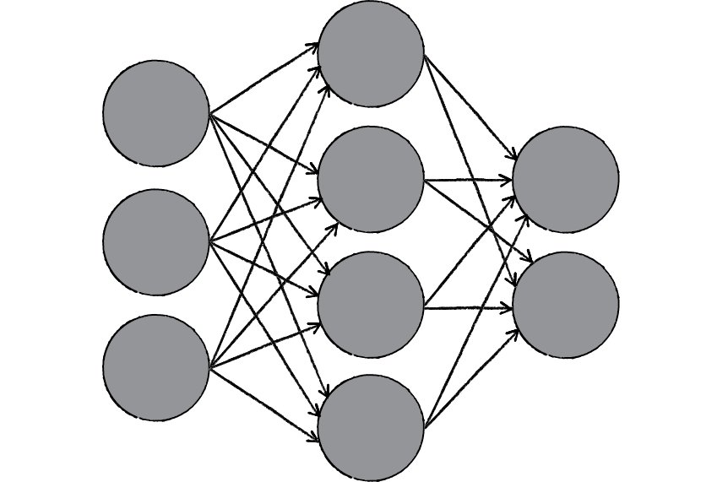

Adversarial black box attacking
Model working on domain A
Hidden architecture and parameters
Attack the target model
Collect data from the same or close domains
Create adversarial examples
Train a model with common architecture

Slide 18
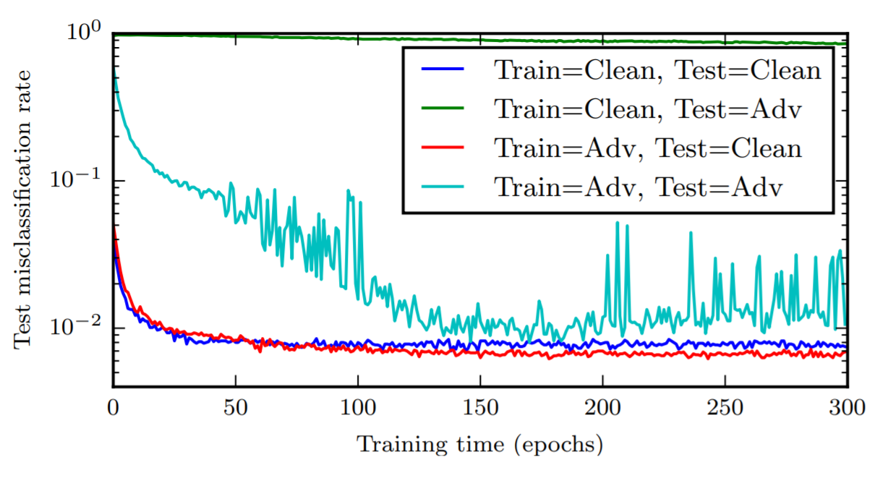
Adversarial training
Train the model with normal sample
Prepare the adversarial samples using iterative or fast gradient sign methods
Further train the model with normal and adversarial samples
$$ℓ\left(x,x_{adv};\hat{y},θ\right)=ℓ\left(x;\hat{y},θ\right)+ℓ\left(x_{adv};\hat{y},θ\right)$$
Explaining and Harnessing Adversarial Examples. 2015. https://arxiv.org/abs/1412.6572
https://www.iangoodfellow.com/slides/2017-05-30-Stanford-cs213n.pdf

Slide 19
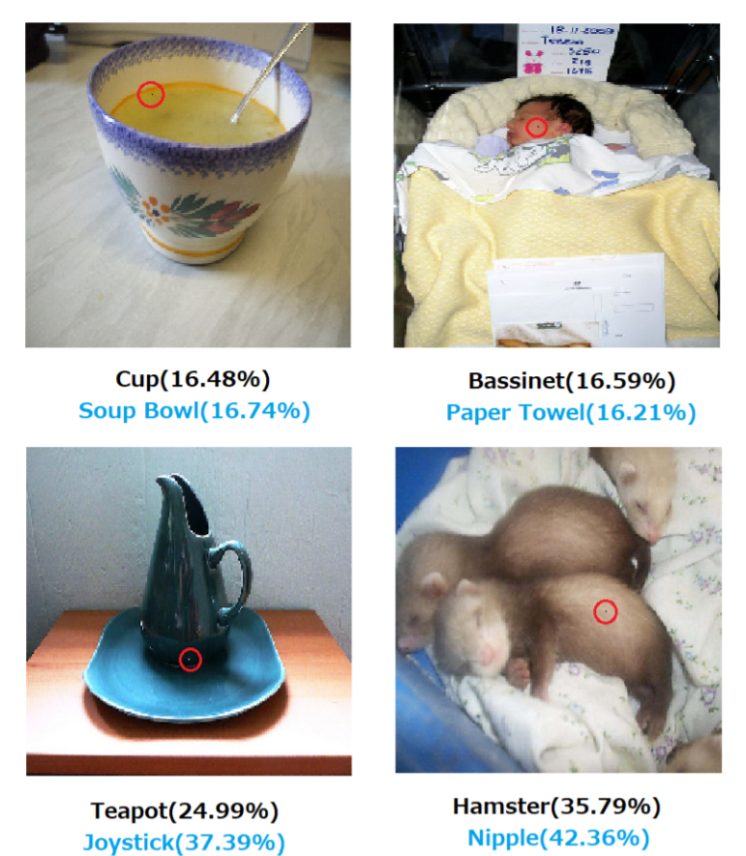
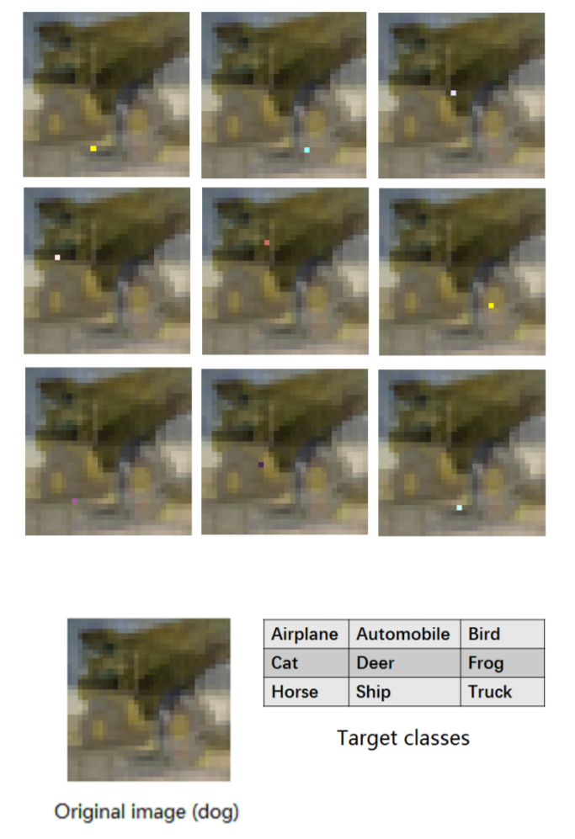
Attacking methods advance
One-pixel attack
Target and un-target perturbation are possible
16.04% of the ImageNet (ILSVRC 2012) test images can be perturbed to at least one target class by modifying just one pixel
One pixel attack for fooling deep neural networks. 2019. https://arxiv.org/abs/1710.08864

Slide 20
Outline
Adversarial examples and adversarial training
Visualization of deep neural networks

Slide 21

Motivation
Curiosity
Block-box solution may not be satisfying
Difficulties in R&D
Path to more general AI
“Machine learning' algorithms that can be reasonably described as pouring data into linear algebra and stirring until the output looks right” – from https://www.explainxkcd.com/wiki/index.php/1838:_Machine_Learning
https://www.explainxkcd.com/wiki/index.php/1838:_Machine_Learning

Slide 22
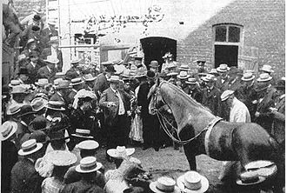
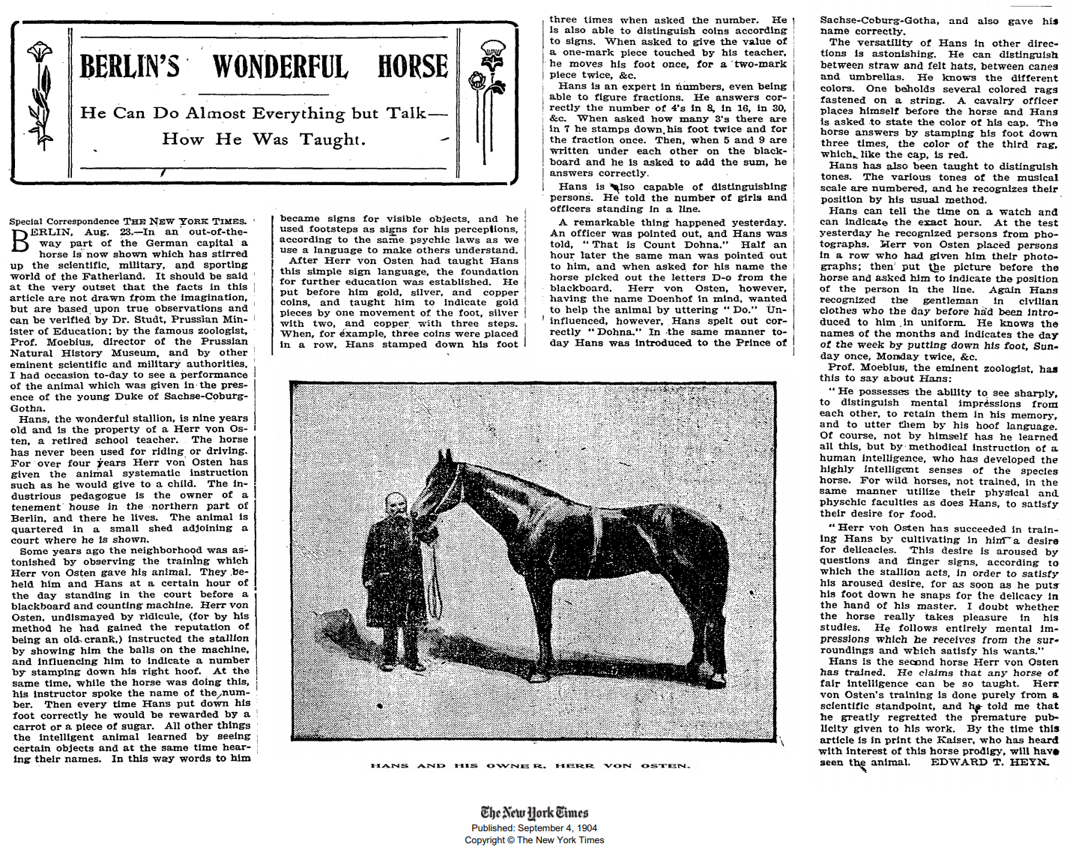
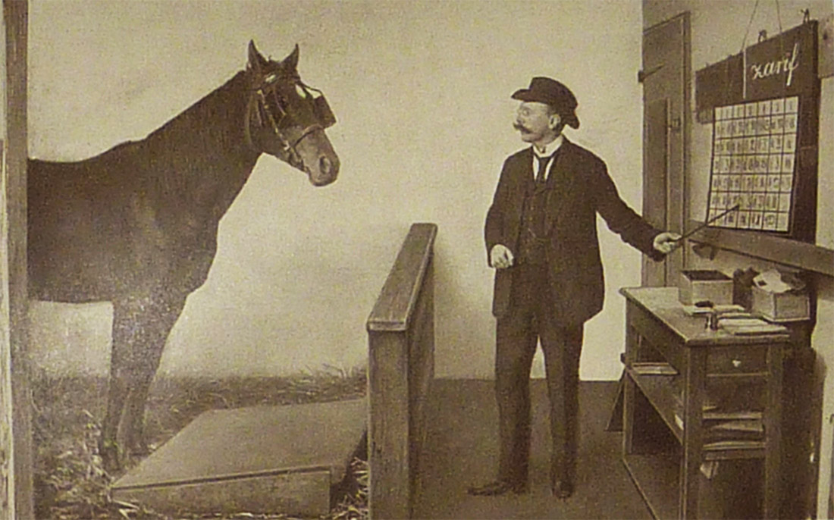
Motivation
problem solving does not mean intelligence in general
https://www.damninteresting.com/clever-hans-the-math-horse/
https://en.wikipedia.org/wiki/Clever_Hans#cite_note-nytimes1904-3
Animal intelligence to solve math problem?
Learn from surrounding human’s face gestures
Are NN the same horse?
"BERLIN'S WONDERFUL HORSE; He Can Do Almost Everything but Talk—How He Was Taught" (PDF). The New York Times. 1904-09-04. Retrieved 2008-02-26.

Slide 23
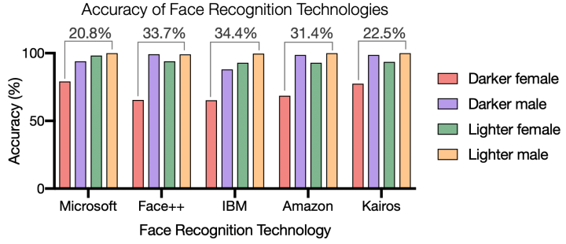
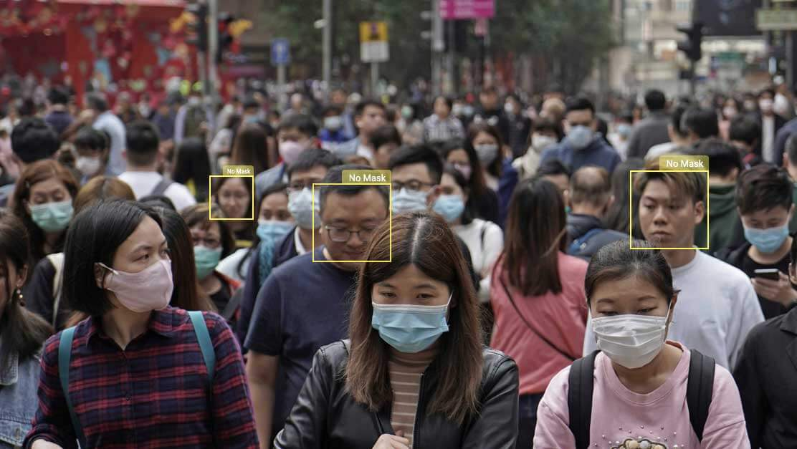
Motivation
Fairness and bias
Need to understand “black-box” to build fair and trustworthy AI system
Detect and alarm data bias
Control AI system within the range of consent
Accuracy varies for gender and race
Do you agree?
Gender Shades: Intersectional Accuracy Disparities in Commercial Gender Classification. http://proceedings.mlr.press/v81/buolamwini18a/buolamwini18a.pdf
https://www.appsstore.ai/app-details/face-mask/?utm_source=facemaskpagelht

Slide 24
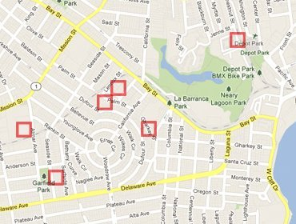
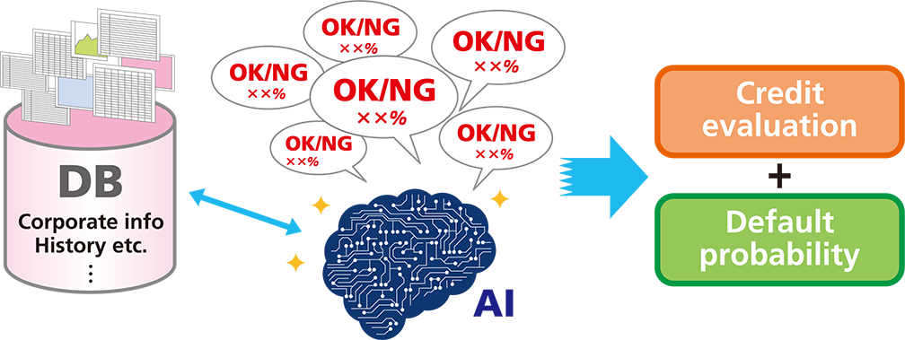
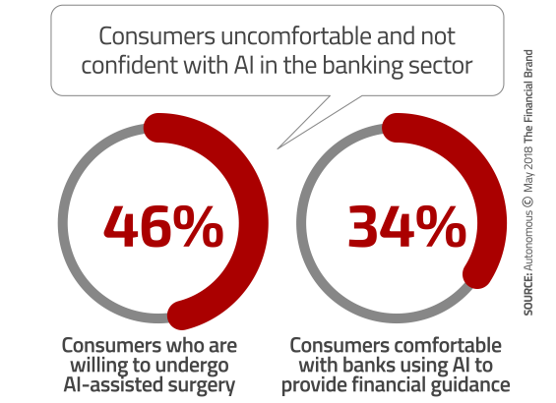
Motivation
Business requirement, legal requirement
There are cases where decision/prediction made mainly by an AI system needs to explained to human
AI for Crime Prediction
http://www.predpol.com/
AI for loan underwriting
2018, https://thefinancialbrand.com/

Slide 25
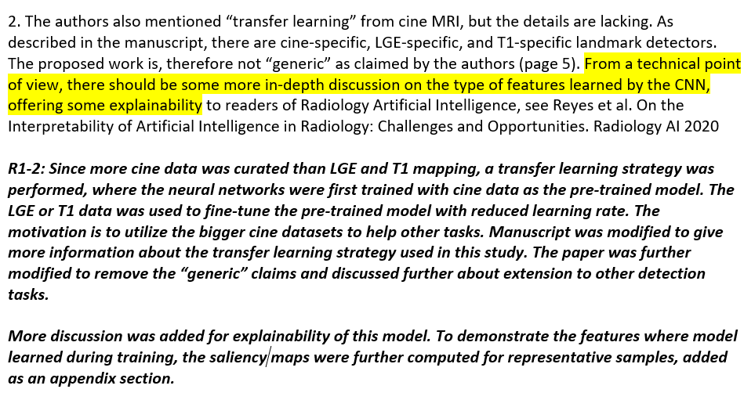
Motivation
Research needs
Example of a reviewer’s comment

Slide 26
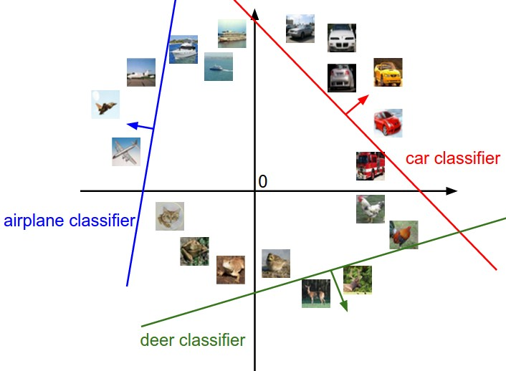
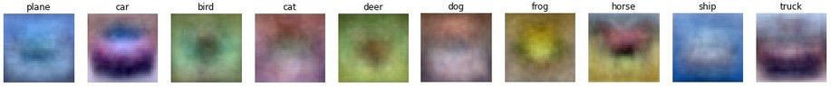
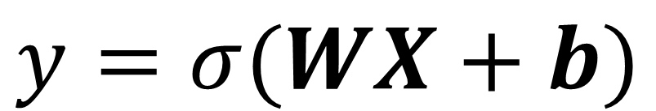
Simple models are more interpretable
$$y=σ(WX+b)$$
Decision boundary is linear – hyperplane
Visualizing the weights gives clue for every class – template matching
Figures from https://cs231n.github.io/linear-classify/

Slide 27


First layer weights
11x11, Input channel 3, output channel 64
ImageNet Classification with Deep Convolutional Neural Networks. NIPS 2012
Deep Residual Learning for Image Recognition. CVPR 2016.

Slide 28


Activation and corresponding image patches
activation
Image patches triggering this activation
Select a batch of image
Pass images through the network
Track the top activations and corresponding image patches (receptive fields)
First layer is simple image feature detector
Visualizing and Understanding Convolutional Networks. https://arxiv.org/abs/1311.2901

Slide 29


Deeper layers focus on higher level content
Intermediate layers are activated for compound image structures
Visualizing and Understanding Convolutional Networks. https://arxiv.org/abs/1311.2901

Slide 30

Deeper layers focus on higher level content
Later layers focus on global structures and image content
Visualizing and Understanding Convolutional Networks. https://arxiv.org/abs/1311.2901

Slide 31
Output layer : compact representation
Neural network model compresses the image to a compact vector representation
e.g. Alex net, 224x224x3 -> 1000

Slide 32

Output layer : nonlinear feature extraction
Query images
Images with closest feature vectors in L2 norm
Neural network worked as a nonlinear feature extraction
Convert complex image content to linearly separable feature vector!
A linear classifier

Slide 33


Output layer : nonlinear feature extraction
https://cs.stanford.edu/people/karpathy/cnnembed/cnn_embed_6k.jpg
Project to 2D using t-SNE

Slide 34




End-to-end visualization: Occlusion
Mask off some portion of image
Compute prediction probability
Sliding the mask across the image
Visualizing and Understanding Convolutional Networks. https://arxiv.org/abs/1311.2901

Slide 35



Saliency map for classification: Class Activation map
scores
$$y=\left[\begin{matrix}cat & 1.2 \\ \begin{aligned}panda \\ gibbon \\ …\end{aligned} & \begin{aligned}16.6 \\ 0. 23 \\ …\end{aligned}\end{matrix}\right]$$
softmax
$$x$$
More accurate the classifier, the higher the corresponding score
For every pixel in the image, how does it influence the score?
For multi-channel inputs (e.g. rgb), take the maximal value across channels
Or, keep three channels still as r,g,b
$$\left|\frac{∂Score_panda}{∂x}\right|$$
Deep Inside Convolutional Networks: Visualising Image Classification Models and Saliency Maps. arXiv:1312.6034v2

Slide 36



Saliency map for classification
Deep Inside Convolutional Networks: Visualising Image Classification Models and Saliency Maps. arXiv:1312.6034v2

Slide 37





Saliency map with MonteCarlo
$$\left|\frac{∂ℓ}{∂x}\right|$$
$$x$$
for i in range(50):
saliency_map += compute(X + sigma*np.random.rand(X.shape))
saliency_map /= 50
SmoothGrad: removing noise by adding noise. https://arxiv.org/abs/1706.03825

Slide 38



Saliency map with MonteCarlo
May need to experiment different noise levels
Can be a useful trick
SmoothGrad: removing noise by adding noise. https://arxiv.org/abs/1706.03825

Slide 39



Saliency map for segmentation
$$ℓ_{seg}\left(x\right)=\frac{1}{N}\sum_{i=0}^{N−1}{ℓ_{ce}\left(x^{(i)}\right)}$$
$S(x)=\left|\frac{∂ℓ_{seg}}{∂x^{(i)}}\right|$ for every pixel
Compute with one backprop to input
Automated detection of left ventricle in arterial input function images for inline perfusion mapping using deep learning: A study of 15,000 patients. 2020. https://onlinelibrary.wiley.com/doi/full/10.1002/mrm.28291

Slide 40


Saliency map for segmentation
2D+T
Dynamic saliency map
Automated detection of left ventricle in arterial input function images for inline perfusion mapping using deep learning: A study of 15,000 patients. 2020. https://onlinelibrary.wiley.com/doi/full/10.1002/mrm.28291

Slide 41



Saliency map on the CONV layer: Grad-CAM
CONV layer generate activations
Focus on image content and global structure
IDEA: activation after CONV modules tell where the model put its focus
Use CONV activation $A^{k}, k=0,…,N−1$, a total of N channels
Grad-CAM: Visual Explanations from Deep Networks via Gradient-based Localization. 2019. https://arxiv.org/abs/1610.02391

Slide 42


Saliency map on the last CONV layer: Grad-CAM
class score
Loss func
For all N activations after CONV modules, how can they be combined to indicate the model’s focus?
Compute weighing coefficient for every activation
Use the derivative of class score or loss to $A^{k}$
Grad-CAM: Visual Explanations from Deep Networks via Gradient-based Localization. 2019. https://arxiv.org/abs/1610.02391

Slide 43

Saliency map on the last CONV layer: Grad-CAM
class score
Loss func
Weighted sum of activations
Go through a ReLU, since we want score to be high positive number for correct class
Grad-CAM: Visual Explanations from Deep Networks via Gradient-based Localization. 2019. https://arxiv.org/abs/1610.02391

Slide 44


Saliency map on the last CONV layer: Grad-CAM
Gain popularity, especially in imaging applications
Flexible for many architectures using CNN
Can create visualization for activation outputs in the middle of network
Often require interpolation to upsample the visualization
Grad-CAM: Visual Explanations from Deep Networks via Gradient-based Localization. 2019. https://arxiv.org/abs/1610.02391
“Cat”

Slide 45

Other flavors
https://github.com/jacobgil/pytorch-grad-cam

Slide 46

Saliency map for adversarial examples
Train a binary classifier to take both image and saliency map as inputs
100% accuracy on detecting adversarial perturbations on MNIST dataset and show above 90% accuracy on CIFAR10.
Saliency map is derived from gradient → can amplify the data shift to favor detection
Detecting Adversarial Perturbations with Saliency. https://arxiv.org/pdf/1803.08773.pdf

Slide 47

Saliency map can be useful
Positive pneumonia
False positive, recognize drainpipe on patient chest x-ray as hotspot
Comparison of Deep Learning Approaches for Multi-Label Chest X-Ray Classification. Scientific Reports volume 9, Article number: 6381 (2019)

Slide 48
Saliency map can be useful

Slide 49


But use it with care
Deep learning saliency maps do not accurately highlight diagnostically relevant regions for medical image interpretation. https://www.medrxiv.org/content/10.1101/2021.02.28.21252634v1.full. March. 2021

Slide 50

Guided backprop
Take one activation from a CONV layer, e.g. one value in 28x28x512 activation array
Compute its gradient to input image x
Gradient magnitude shows the part of image content activating this neuron
Very Deep Convolutional Networks for Large-Scale Image Recognition. VGG 16
Deep Inside Convolutional Networks: Visualising Image Classification Models and Saliency Maps. arXiv:1312.6034v2

Slide 51

Guided backprop
Improve the localization of class object
Change is on ReLU layer
Only backprop through ReLU layer if input value is positive and gradient is positive
Striving for Simplicity: The All Convolutional Net. https://arxiv.org/abs/1412.6806

Slide 52

Guided backprop
conv6
conv9
Striving for Simplicity: The All Convolutional Net. https://arxiv.org/abs/1412.6806

Slide 53


Gradient Ascending
Global explanation of the trained model
Generate an image to maximize a specific class core or loss
Class score
Regularization
Start from x=0
Backprop to x
Update x with gradient
Deep Inside Convolutional Networks: Visualising Image Classification Models and Saliency Maps. https://arxiv.org/abs/1312.6034

Slide 54


Gradient Ascending
Same scheme can be used to compute images to maximize an intermediate neuron
Understanding Neural Networks Through Deep Visualization. https://arxiv.org/abs/1506.06579

